Slide 1
Anxiety in Children
Garrett Park Elementary Principal’s Coffee December 9, 2016

Slide 2
Types of Anxiety
General Anxiety Disorder
Panic Disorder
Separation Anxiety
Social anxiety
Selective mutism
Specific phobias
Obsessive Compulsive disorder
Post Traumatic stress disorder

Slide 3
The Four D’s
Disproportion: excessive, unreasonable, and well out of proportion to the situation of the trigger
Disruption: affects the ability of the child to function normally
Distress: the child has become distraught or unhappy
Duration: a significant level of anxiety consistent for an extended amount of time (>1 month)

Slide 4
Supports at Garrett Park
Individual Responsive Counseling
Mrs. Catucci (K, 2nd, 4th, 5th)
Mrs. Kemp (1st & 3rd)
Small Group Counseling
Lunches Bunches
Classroom Lessons

Slide 5
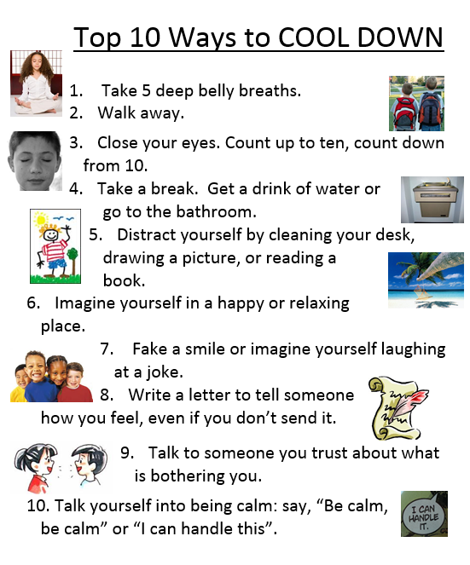

Slide 6
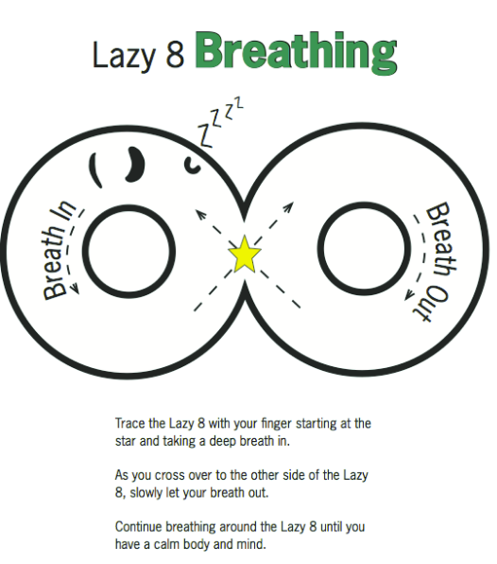
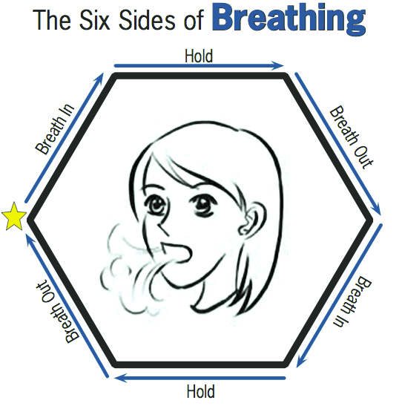
DEEP BREATHING

Slide 7
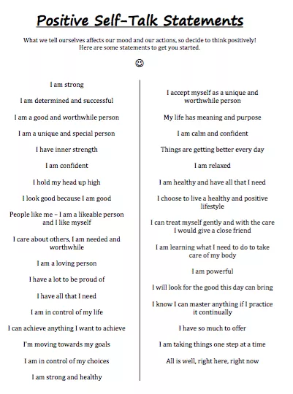
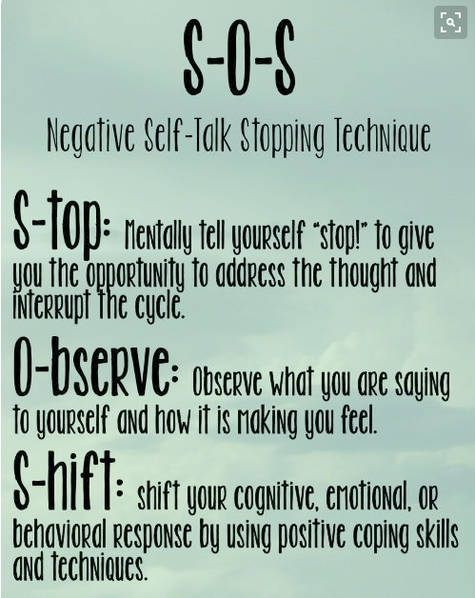
POSITIVE SELF TALK

Slide 8
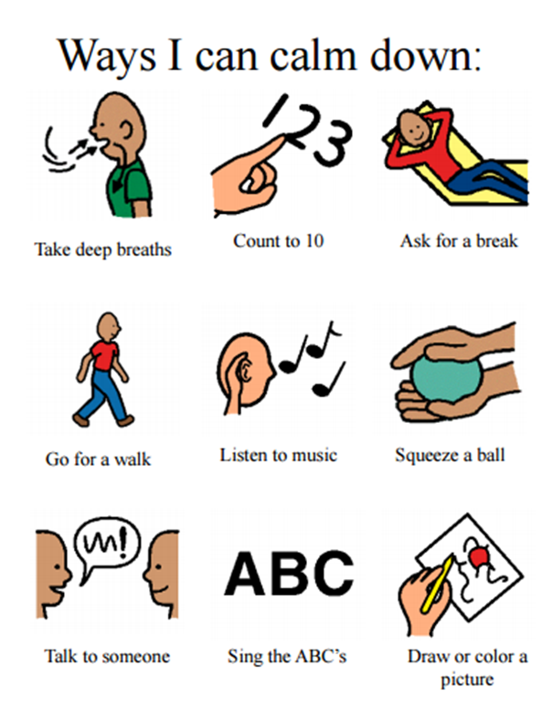
STUDENT RESOURCES

Slide 9
PARENT RESOURCES
What to Do When You Worry Too Much: A Kid's Guide to Overcoming Anxiety (What to Do Guides for Kids) by Dawn Huebner
The Anxiety Workbook for Kids: Take Charge of Fears and Worries Using the Gift of Imagination by Robin Alter PhD CPsych
Helping Your Anxious Child: A Step-by-Step Guide for Parents by Ronald Rapee PhD
Freeing Your Child from Anxiety: Powerful, Practical Solutions to Overcome Your Child's Fears, Worries, and Phobias by Tamar Chansky Ph.D.

Slide 10
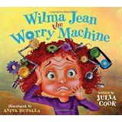
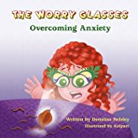
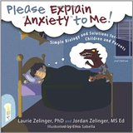
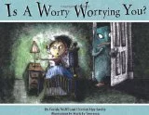
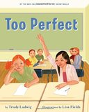
Children’s Books

