Slide 1
Montgomery County Public Schools
School-Wide Positive Behavioral Interventions & Supports
Positive Behavioral Interventions and Supports (PBIS) at Home
How Parents Can Support Positive Behavior at Home
Mike Muempfer
PBIS Specialist
Montgomery County Public Schools
michael_j_muempfer@mcpsmd.org
Notes:
Since we began to implement PBIS in Maryland in 1999, we have been working with Dr. George Sugai, then at the Univ. of Oregon, but just recently relocated to Connecticut.
I am ________, co coordinator for PBIS in Maryland.
I will be presenting an overview of PBIS – some big ideas and themes - this type of presentation has the potential to last more than 2 hours, we plan to be done in __ minutes and allow time for Q&A.
It will work best if you ask questions as we proceed, if we will be covering the topic later, we will let you know.
And, if in fact we get bogged down in a one on one conversation, not material to the rest of the audience, please allow me to defer further conversation onto the end of the presentation - I can remain for _______

Slide 2
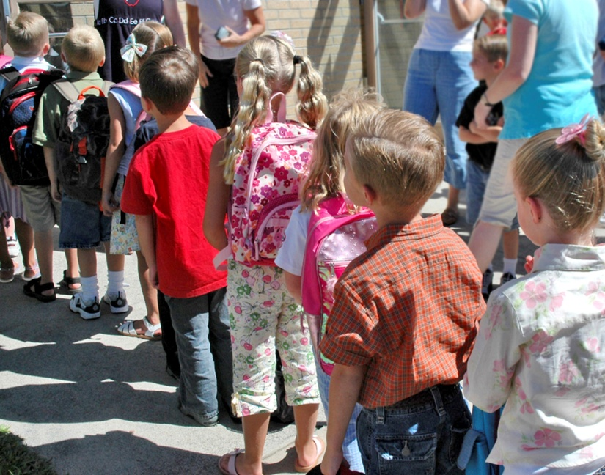
Goals for the workshop
  Understand the philosophy of the PBIS system
  Learn how PBIS is implemented in schools
  Collect and implement strategies on how to use PBIS in the home and community

Slide 3
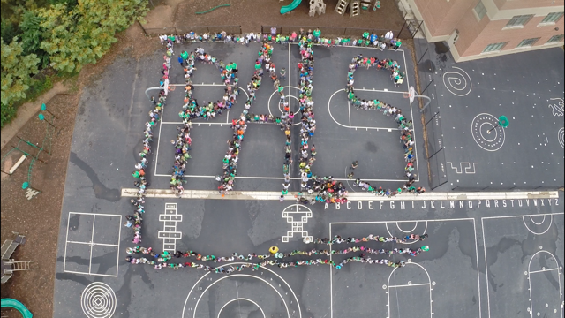
What is PBIS?
Positive Behavior Interventions and Supports (PBIS) is a framework for a school that supports a positive school climate and positive behavior in school.
  Implemented in 109 MCPS Schools

Slide 4
PBIS
PBIS is a pro-active reinforcement based system rather than a reactive consequence based system.
The focus is teaching behaviors that lead to academic success.
Praise/Recognition is a powerful strategy that supports generalization

Slide 5
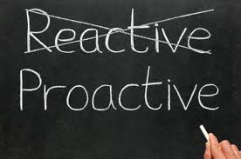
Proactive towards student success!
PBIS works on creating a proactive approach teaching students the expectations through:
  Modeling expected behavior
  Matrixes
  Direct Social Skills Instruction
  “Teachable Moments”

Slide 6
Can we MAKE students behave?
We can’t make kids learn or behave, but we have the power to increase the likelihood by creating a positive environment and teaching. In other words, PBIS aims to improve school climate.

Slide 7
The Basics
Behavior is learned
Do not assume children know your rules, expectations, or social skills
Every social interaction you have with a child teaches him/her something

Slide 8
The Basics
Behavior communicates need:
Children engage in behavior(s) to "get" what they find reinforcing or to "avoid" what they find aversive

Slide 9
Behavior = Communication
Every behavior has a function:
Escape
Attention
Tangible Desires (food, item, activity)
Control

Slide 10
We have the Power
Our reaction to a particular situation can escalate or de-escalate behavior
Control Environmental Factors
Control Task Presentation
Eliminate Emotional Cues
Avoid a Spiral of Conflict

Slide 11
I Believe
I believe that parents are the child’s first and most important teacher.
I believe that the schools cannot do it alone.
I believe that we must work as a team.

Slide 12
Beliefs and Facts
Parent values are instilled in our youth
7,200 students dropout daily in the US
A 4 year college graduate makes 1 million dollars more in their lifetime than a high school graduate.
Teach your child to develop goals
Children laugh 400 times a day
Adults laugh 15 times per day

Slide 13
A thought…
“So often, children are punished for being human. Children are not allowed to have grumpy moods, bad attitudes, disrespectful tones, or bad days, yet we adults have them all the time. None of us are perfect, and we must stop holding children to a higher standard of perfection than we can attain ourselves”

Slide 14
teach.
  “If a child doesn’t know how to read, we
  If a child doesn’t know how to swim, we
teach.
  If a child doesn’t know how to multiply, we
teach.
  If a child doesn’t know how to drive, we
teach.
  If a child doesn’t know how to behave, we...
teach? punish?
  Why can’t we finish the last sentence as automatically as we do the others?”
  The bottom line: Teaching
  Teach Expectations
  Teach Routines and Procedures
Notes:
The following quote by Tom Herner expresses our difficulties with dealing with challenging behavior. Read quote. Do we regard behavior as a skill deficit that needs to be taught or do we perceive it as something that needs to be punished? If we perceive it as something to be punished then it is very clear that we regard it differently than any of the other behaviors or skills that we address at school. As a result, we tend to approach it in less-effective and less-professional ways. Appropriate behavior should be taught just like reading, swimming or driving.

Slide 15
Tertiary Prevention:
Specialized
Individualized
Systems for Students with High-Risk Behavior
CONTINUUM OF
SCHOOL-WIDE
PBIS
~5%
Secondary Prevention:
Specialized Group
Systems for Students with At-Risk Behavior
~15%
Primary Prevention:
School-/Classroom-
Wide Systems for
All Students,
Staff, & Settings
~80% of Students
Notes:
Here is our triangle (another fridge magnet) – actually stolen from the public health literature-
If you ask the kids to do something – 80% will get it the first time –kind of like academics, when you want kids to add 2 plus 2 – and give them some prompts – 80 percent will get it, 15 % will need extra instruction (pull out programs) and 5 % will need lots of help
The same with behavior – 80 % will follow general rules – 15 % will need small group support (check in check out) and 5 % will need lots of support –
The beauty of this model is that it gives us the ability to more efficiently use the very limited resources that are required to support those red zone kids. (special ed/wrap around)
I could flip this slide – but I wont, let’s just chat about the adults in the school – 80% will support implementation, 15 % will need more info/time – and then there are the “been bees” I have been here before you started this program and I will be here after it goes away (I only have a few years to retire and I don’t want to do this etc etc..
We really want 80 % of the faculty on board before implementation, because the school needs the majority of the staff to support implementation – without 80 – there will be too many nay Sayers and they will sabotage the implementation efforts. Don’t need 80% to come to training, but need 80 % to implement. If they don’t have 80%, then the action plan becomes how do we get 80%, not how do we implement.
SAY: One of the most important organizing components of PBS is the establishment of a continuum of behavior support that considers all students and emphasizes prevention. This logic of this 3-tiered approach is derived from the public health approach to disease prevention.
All students and staff should be exposed formally and in an on-going manner to primary prevention interventions. Primary prevention is provided to all students and focuses on giving students the necessary pro-social skills that prevents the establishment and occurrence of problem behavior. If done systemically and comprehensively, a majority of students are likely to be affected.
Some students will be unresponsive or unsupported by primary prevention, and more specialized interventions will be required. One form of assistance is called secondary prevention, and is characterized by instruction that is more specific and more engaging. These interventions can be standardized to be applied similarly and efficiently across a small number of students. The goal of secondary prevention is to reduce/prevent the likelihood of problem behavior occurrences, and to enable these students to be supported by the school-wide PBS effort.
If primary prevention is in place, a small proportion of students will require highly individualized and intensive interventions. The goal or tertiary level interventions is to reduce the intensity, complexity, and impact of the problem behaviors displayed by these students by providing supports that are (a) function-based, (b) contextually appropriate and person-centered, (c) strength-based and instructionally oriented, (d) continuously evaluated and enhanced, and (e) linked to the school-wide PBS approach. The inspiration for the Pyramid Model comes from the public health model of promotion, prevention, and intervention. Similar to the public health model, we describe the need for universal, secondary, and tertiary interventions. At the universal level we include the practices needed to ensure the promotion of the social emotional development of all children. At the next level, the prevention level includes the provision of targeted supports to children at risk of challenging behavior. Finally, the tertiary level of the pyramid describes the need to provide individualized and intensive interventions to the very small number of children with persistent challenges

Slide 16
Critical Elements
PBIS Team
Faculty/Staff Commitment
Expectations and Rules Developed
Plans for Teaching expectations/rules
Reward/Recognition Program Established
Effective Procedures for Dealing with Problem Behaviors
Data Entry and Analysis Plan Established
Classroom Systems
Evaluation
Implementation Plan

Slide 17
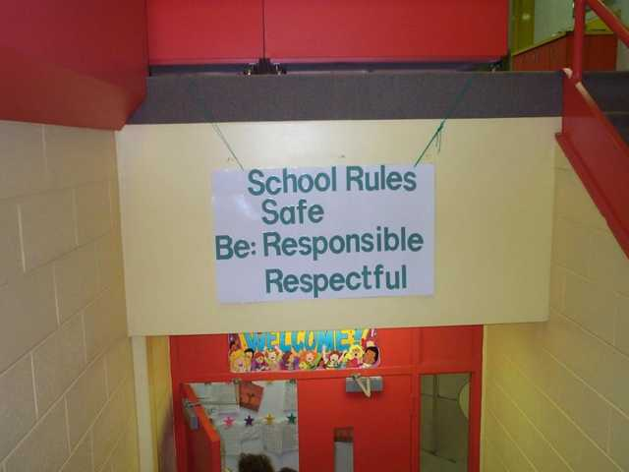
School Rules
NO Food
NO Weapons
NO Backpacks
NO Drugs/Smoking
NO Bullying
Redesign Learning & Teaching Environment
Notes:
As you enter this school you get - Lots of NO NO NO
What we want are a few - positively stated behavioral expectations for the school—
posted everywhere—in all venues.
Changing adult mindset. We really do expect it, and we have to teach what it means, and reward them for successful accomplishment of the task.
WHY 3-5—We should have at least 3 but if we have more than 5, even the adults are going to forget them—remember your 6-inch binder—how many have that memorized??
But – some will say – they should already know these things – I AGREE!!, but what if they don’t, we should suspend them right?? They will learn respectful behavior while – at home, in the hood,
What we all too often fail to recognize is that the behavior they are displaying actually works for them is some venue (home), that behavior ahs become “efficient for them - why would they use different “skills” here in the school, unless we teach them differently? Until we make the use of the behaviors that we want to see more efficient for the kids, they will continue to use the behavior that they fell is efficient.

Slide 18
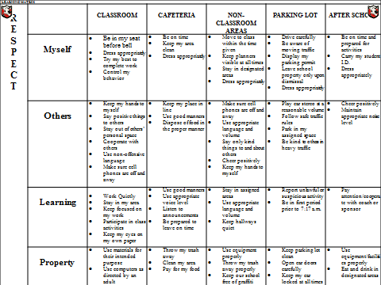
PBIS Matrix at School
Provide initial lesson plans and/or lesson plan format to teach specific behaviors identified on the Matrix
CAFETERIA
Be on time Keep my area clean Dress appropriately
Keep my place in line Use good manners Dispose of food in the proper manner
Use good manners Use appropriate voice level Listen to announcements Be prepared to leave on time
Throw my trash away Clean my area Pay for my food
Notes:
Social skill lessons are based on school data
Behavioral instruction is infused into all instruction
Procedures are understood and practiced by administrators, staff, students, and families

Slide 19
Procedures and Routines
Define and TEACH classroom routines
    How to enter class and begin to work
    How to predict the schedule for the day
    What to do if you do not have materials
    What to do if you need help
    What to do if you need to go to the bathroom
    What to do if you are handing in late material
    What to do if someone is bothering you.
    Signals for moving through different activities.
      “Show me you are listening”
Establish a signal for obtaining class attention
Teach effective transitions.
Remember: Think of student misbehavior as:
Learning Errors

Slide 20
EXPECTATIONS | Classroom Procedures/Routines
 | Class-Wide | Arrival | Cooperative Learning Groups | Independent Seat Work | Whole Group
 | Identify Attention Signal…….Teach, Practice, Reinforce
Be Respectful | Listen to others Use inside voice Use kind words Ask permission | Enter/exit classroom prepared Use inside voice | Listen to others Accept differences Use kind words Encourage others | Use quiet voice Follow directions | Eyes/ears on speaker Raise hand to speak Contribute to learning
Be Responsible | Be prepared Follow directions Be a problem solver Make choices that support your goals | Place materials in correct area Begin warm-up promptly | Use Time Wisely Contribute Complete your part | Be a TASK master Use your neighbor | Follow directions Take notes Meet your goals
Be Safe | Keep hands, feet, and objects to self Organize your self Walk | Walk | Use Materials Carefully | Keep hands, feet, and objects to self | Stay at seat Keep hands, feet, and objects to self
Notes:
Handout in folder. The Focus Strategy and Notice Your Neighbor are from the Community Building Series of the KU. They can be purchased from Edge Enterprises. We will review these strategies today.

Slide 21
Developing a System for Teaching Appropriate Behavior
Doing this creates a safe and predictable environment
Allows for prefrontal cortex activity
Disengages the amygdala
Helps to foster authentic relationships with students (you can’t do this if the amygdala is overactive)
Some student’s amygdala triggers are quicker than others (exposure to trauma, genetics, developmentally appropriate, nutrition, etc.)
Notes:
Can’t just put the expectations and rules on the wall and walk away..
If you emphasize “it” the students will see it’s importance
If you model “it” the students will learn how to do “it”.
Consistently provide students with feedback, emphasizing students who are doing “it”.

Slide 22
Why Develop a System for
Teaching Behavior?
Behaviors are prerequisites for academics.
Procedures and routines create structure.
Repetition is key to learning new skills.
  For a child to learn something new, it needs to be repeated on average of ? Times (Joyce and Showers, 2006)
  Adults average ? (Joyce and Showers, 2006)
  For a child to unlearn an old behavior and replace with a new behavior, the new behavior must be repeated on average ? times (Harry Wong)
8
25
28
Notes:
We can’t assume:
that students know the expectations/rules and appropriate ways to behave
That students will learn appropriate behaviors quickly and effectively without consistent practice and modeling
We must assume:
Students will require different curricula, instructional modalities supports, etc., to learn appropriate behavior
We need to teach expectations/rules and appropriate behaviors as effectively as we teach academic skills

Slide 23
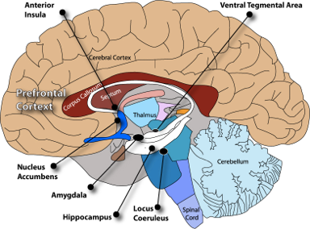
Pre/Adolescent Brain…
Dopamine synthesized in VTA
associated with Self-Regulation (VTA shrinks during adolescence)
Routines
dampen fear and anxiety reactions
Routines signals safety to
the Amygdala
Re-teaching of expectations encode memory of predictability and safety
Alarm circuits increase in Locus Coeruleus by using harsh actions/exclusionary discipline
Copyright © 2011-13, PAXIS Institute. Only for use by accredited PAX GBG Coaches and licensed by PAXIS.
Notes:
The PAX Game and its various tools affect the brain dramatically. You can read more about that in the manual’s preface.
(Coaching note: If you have some experience implementing the Game, you can chime in your own experience here of the effects you see on cognitive and behavioral skills).

Slide 24
Biggest misconception of PBIS is the recognition system
Difference between bribery and recognition
Tickets are not only designed to change student behavior
Tickets are also designed to change adult behavior
Ticket designed to prompt conversation (relationship building)
Conversation/relationship changes the behavior
What matters is the positive social engagement (know your students)
Not used as general praise

Slide 25
Proven Reinforcers to Create a Climate of Appreciation in Your School (L. Riffel)
Privileges (Earning special privileges)
Attention (Quality Time with Adults and Peers)
Leadership (Earning Leadership Roles)
Praise (Social Praise- Name in Lights)
Assistance (Special Assistance in a Topic of Their Choice)
Touch (High Five)
Escape (Escape from a Task or Chore)
Supplies (School Supplies)

Slide 26
Why Implement PBIS?
Learning Environment:
  Less reactive, aversive, dangerous, and exclusionary
  More engaging, responsive, preventive, and productive
Address classroom management and disciplinary issues (attendance, tardiness, antisocial behavior)
Improve supports for students whose behaviors require more specialized assistance (emotional and behavioral disorders, mental health)
Maximize academic engagement and achievement for all students

Slide 27
PBIS at Home
Helps to build a school and home connection
Teaching and re-teaching behavioral expectations
Positive acknowledgment
Improved behavioral outcomes

Slide 28

The importance of the home, school, community connection
PBIS can be implemented in the home and community settings.
By connecting PBIS at home and school your child gets:
  Consistency
  Common language
  Additional applications of important social/behavioral skills

Slide 29

PBIS at Home Breakdown
To implement PBIS in the home and community, follow these four steps:
1. Set expectations in advance
2.Communicate/teach the expectations
3.Positively reinforce when expectations are met
4. Have a plan to give additional support when expectations are not met

Slide 30
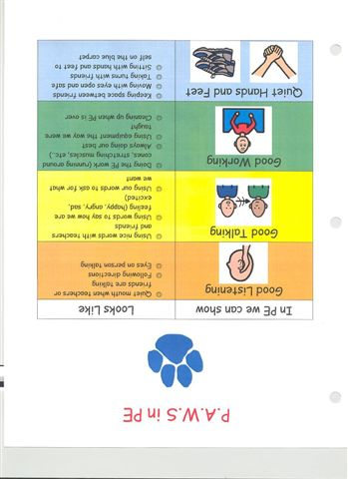
Set Your Expectations in Advance
Simply put, ask yourself, “what is it I want my child to be able to do during dinner or at the movie theatre?”
Knowing your child, set your expectations in a way that is visible and other people could understand if they read it
A home/community matrix is a tool to use when completing this step

Slide 31
Family Teaching Matrix |  | SETTING
 |  | At home | Morning Routine | Homework | Meal Times | In Car | Play | Bedtime
 | Respect Ourselves
 | Respect Others
 | Respect Property
1. SOCIAL SKILL
2. NATURAL CONTEXT
Expectations
3. BEHAVIOR EXAMPLES

Slide 32
My Family’s Matrix
Muempfer Family Matrix | Respect Ourselves | Respect Family Members | Respect Property
At Home… | Listen to Parents Be Honest Use manners | Share Be Kind Help Each Other Golden Rule | Clean-Up When Finished Use Equipment Properly Ask for Help
Morning… | Wake-Up at Appropriate Time Brush Teeth After Breakfast | Say Good Morning Use Kind Words Help Each Other Keep Hands to Self | Make Bed Use Equipment Properly Clean-Up (room, dishes, bathroom, etc.)
Homework… | Quiet Space Get Materials Ask for Help Read Carefully Take My Time | Do Not Disturb Others Be Kind Help Each Other | Get Rid of Distractions Use Equipment Properly Clean-up
Meals… | Make Healthy Choices Take My Time Use Manners | Use Manners Set Table Appropriate Conversations Use Inside Voice | Use Utensils Properly Clean-up When Finished
In Car… | Wear Seatbelt ALWAYS!! Do Not Distract Driver | Use Inside Voice Keep Hands to Self Share | Keep Car Clean No Throwing Items Use Equipment Properly
Play… | Limit Screen Time Go Outside Be Active Be Safe | Share Sportsmanship Be a Role Model Help Each Other | Use Equipment Properly Be Safe
Bedtime… | 8+ Hours of Sleep Go to Bed On-Time | Do Not Disturb Others Shower | No Electronics No Rough-Housing Clean-Up

Slide 33
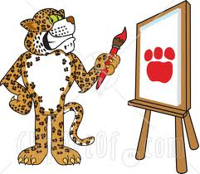
Communicate/Teach the Expectations
Just like any other skill, we must teach our expectations to our children
The most effective and usually easiest way to teach expectations is through modeling them ourselves
Some other methods to use are:
  Social stories or books
  You Tube or other videos
  Siblings/other children modeling
  Use the additional community resources for help with this step

Slide 34
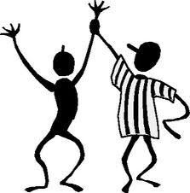
Positive Reinforcement when Expectations are Met
We want to hear when we did a good job and so do our children
Two big areas to plan and practice are:
  What reinforcers should you use
  How often should you reinforce (frequency)

Slide 35
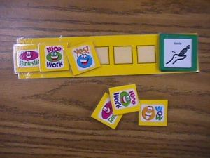
Selecting a Reinforcer
Using a reinforcement inventory is one way to identify reinforcers for your child
It is important to identify both small and large reinforcers for your child
  Example of small: token board
  Example of large: TV time

Slide 36
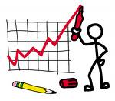
Frequency of Reinforcement
This is the trickiest part of the whole process
Through knowing your child and some trial and error a plan will be created on how often a child needs to be positively reinforced
The goal is for independence so the less you can reinforce the better
Usually when starting the process you will need to reinforce often and in time can lessen the amount
The home/community PBIS chart is a way to give reinforcement

Slide 37
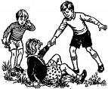
Additional Support
What is the plan if the expectations are not met?
  Re-teach the expectation
  Give additional prompting or support for success
  Time for consequences for their actions
    Not receiving the reinforcer until expectations are met

Slide 38

PBIS is not 100% effective
It would be great if it was but the PBIS system data shows it is effective about 80-85% of the time
The school PBIS team is looking to work together with you in learning from each other in specific workshops designed address specific behavior topics such as:
  Accepting No
  Transitions
  Prompting
  Task Analysis

Slide 39
A Final Thought…
“People often say that motivation doesn’t last. Well, neither does bathing. That’s why we recommend it daily.”
Zig Zigler

Slide 40

Questions

Slide 41
Resources
www.pbis.org
www.pbismaryland.org
www.montgomeryschoolsmd.org
Michael_J_Muempfer@mcpsmd.org

Slide 42
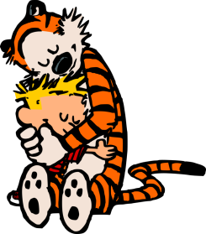
Thank you!

Slide 43

Please Provide Feedback
Your feedback is important to us! Please take a few moments to complete an evaluation for this Coaches’ Meeting.
Use your computer or mobile devise now by entering the following URL: goo.gl/NLk1VM
Please provide an evaluation for EACH session you attended
Be sure to provide feedback on the 4 items at the end of the evaluation – we will use this feedback to inform how we plan future event
Only complete once: the evaluation form will also be emailed to each participant.
Notes:
Please allow 5 minutes at the end of the 2:00-3:00 session for participants to complete the online evaluation form.
Please highlight the following:
Participants should provide an evaluation for EACH session attended. Skip the questions for the one afternoon session not attended.
Please be sure to complete the last 4 items – the SMT uses this feedback to inform future events
This link will be emailed out to each participant. So, for those without internet access today, they can complete the evaluation when they return to school tomorrow.
For those who are completing the evaluation today, please complete this only once – disregard the email you will be receiving from Jerry Bloom.

